Slide 1


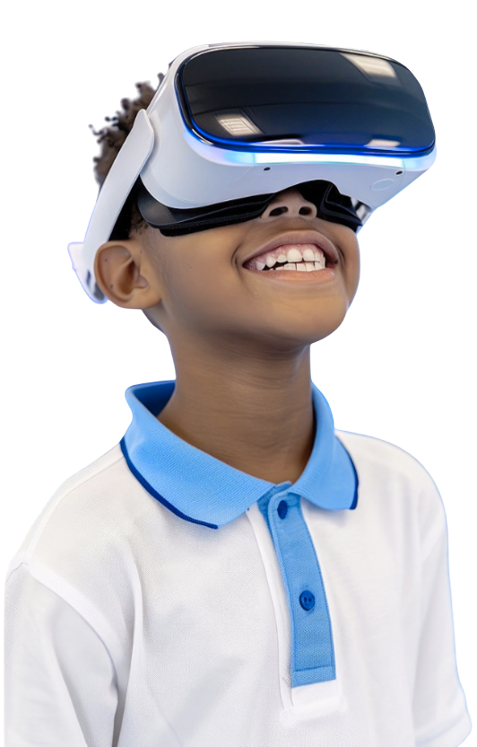
VR/XR
WEEKEND
EXPERIENCE
A LIFE CHANGING IMMERSIVE WEEKEND EXPERIENCE
DISCOVER • CREATE • INNOVATE

Slide 2

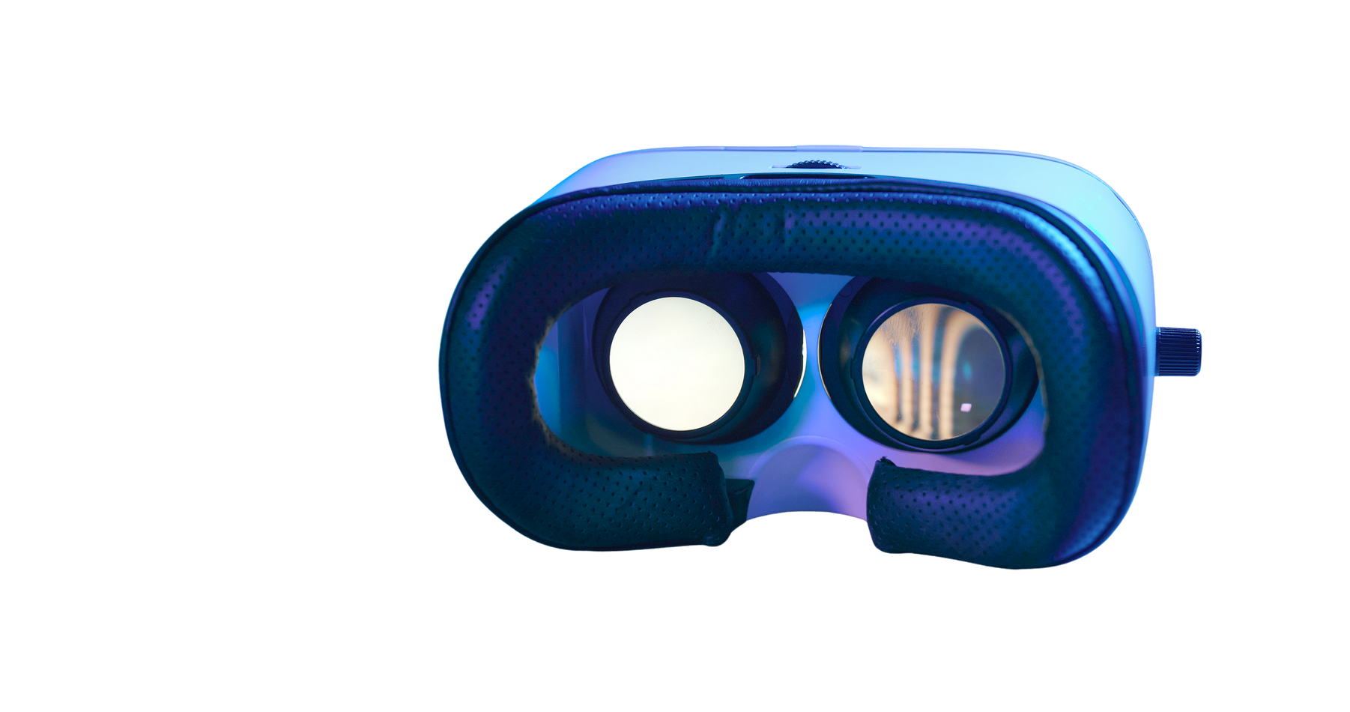





WHY WE ARE BRINGING VR/XR TO STUDENTS
“Used in surgical training”
3D modelling & simulations”
“Virtual walkthroughs”
“Flight training simulators”
(02)

Slide 3
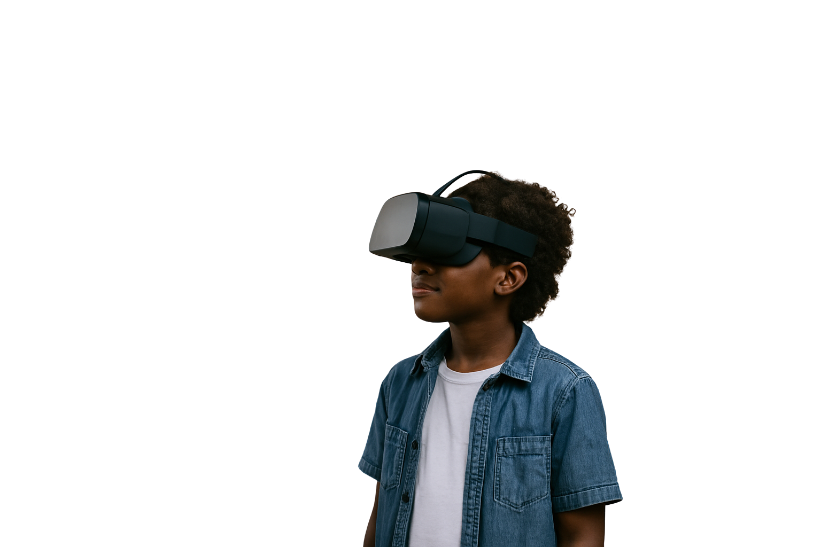
WHAT STUDENTS WILL EXPERIENCE
  Use VR headsets
  Build virtual spaces
  Create simple interactions
  Test projects in VR
  Work in creative teams
  Present to parents
(03)

Slide 4
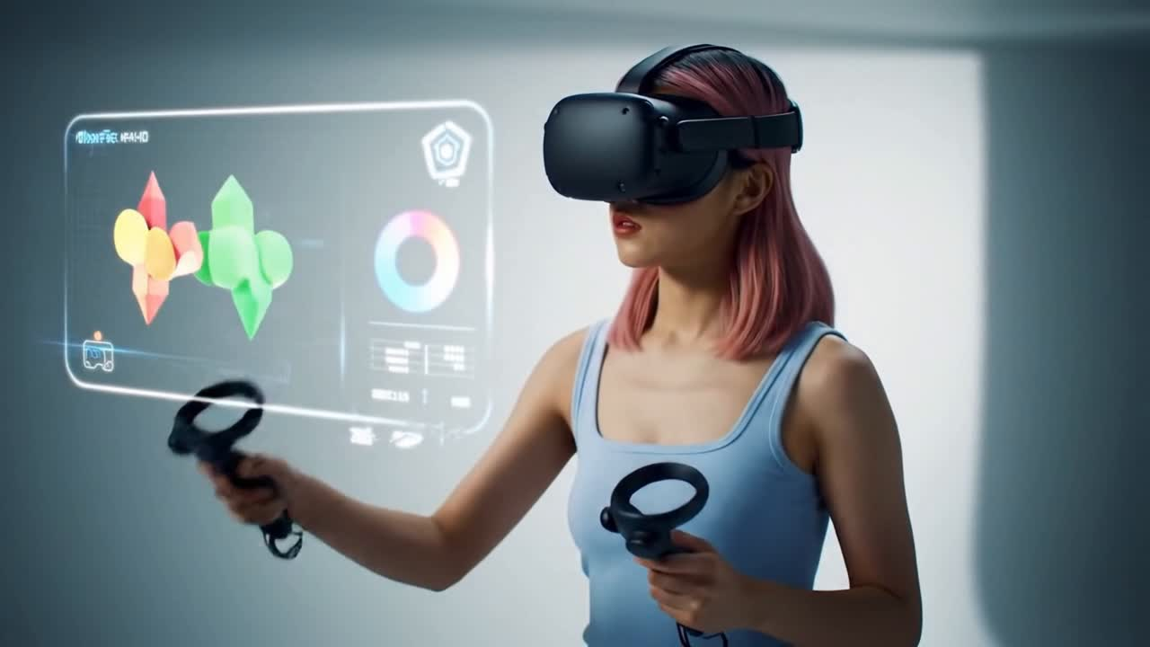
TOOLS THEY WILL USE
(02)
Unity for environment development
(01)
(03)
(03)
High processing Dell Computers for develpment and testing enviroments
Blender , for 3D Assest development
Vr Headset. Meta quest
(05)

Slide 5




2-DAY PROGRAM OUTLINE
DAY 1
TEAM
SETUP
INTRO
TOOLS
BASICS
DAY 2
SHOW
CASE
AWARDS
BUILD
TEST
(06)

Slide 6

WHY THIS MATTERS
STUDENTS
PARENTS
UNIPOD
Creativity boost
Safe & engaging
Innovation visibility
Stronger school outreach
Digital literacy
Academic value
Positive community impact
Early exposure to tech
Skill discovery
(07)

Slide 7

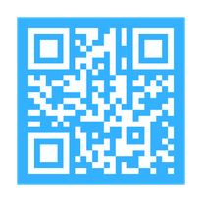
JOIN US
FOR AN
IMMERSIVE
EXPERIENCE
for more information contact:
info@unipod.ac.mw
unipod.ac.mw

